Slide 1
Gippsland Australian Muslim Community Incorporated (GAMCI)
Summary of Years Events
1 July 2014 – 30 June, 2015
Presented at Annual General Meeting
6 October, 2015
Federation University MUGSU Lounge

Slide 2
July - September
Ramadan (meetings) and Eid Festivities in association with MUIS. Publicity on ABC Radio http://www.abc.net.au/local/photos/2014/07/14/4045312.htm
Assisted with the hosting of the Eid Festival on Saturday August 7th. GAMCI did the sausage sizzle, tea and coffee and received a donation from food sales
VMC grant was approved for $1,500 plus GST for Eid Ul Adha.
Presented a Palliative Care for Muslim Patients by Dr Iqbal Zafar Palliative Care Forum, West Gippsland Arts Centre 27th August. http://faithvictoria.org.au/news-a-articles/206-gecc-gippsland-interfaith-ethnic-palliative-care-forum
Applied for Prophet’s Birthday Grant.
Input into Latrobe City Cultural Diversity Advisory Committee Draft Cultural Diversity Action Plan 2014-2018

Slide 3
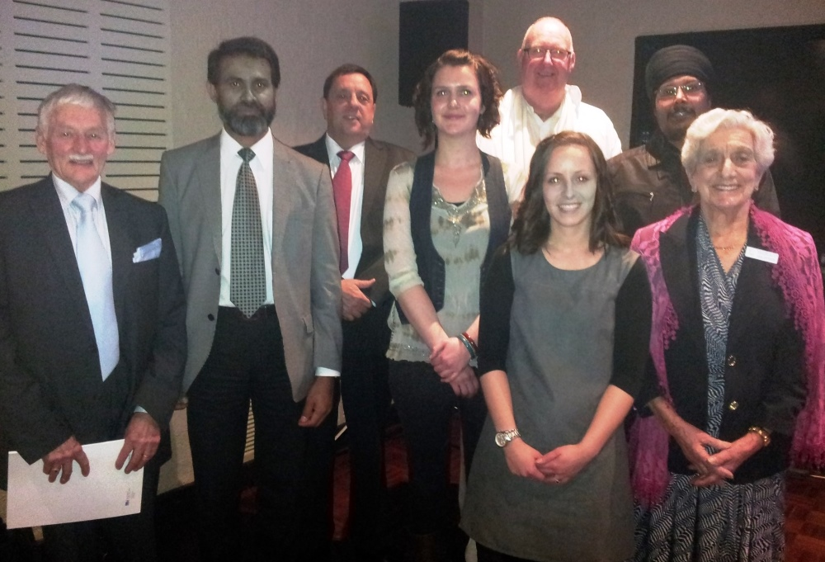
Palliative Care Forum

Slide 4
September – December
The talking faith (People of the book dialogue) scheduled to take place in Drouin Library in September cancelled by GECC.
VMC Grant used for catering for Eid Ul Adha event, and children's sweets.
Eid Ul Adha event organised by GAMCI in October with guests, including VMC commissioner Mr Ting Chin.
GAMCI asked to comment on police raids against suspected supporters of the extremist Islamic State
http://www.latrobevalleyexpress.com.au/story/2597491/celebrating-love-and-peace/
GAMCI attends Victorian Council of Social Service (VCOSS) a consultation with community sector organisations Traralgon
November GAMCI holds AGM. All committee positions filled with same executive
GAMCI’s application from Latrobe City Funding did not receive funding. No religious organisations.
GAMCI applies to VMC for Organisational Support Grant

Slide 5
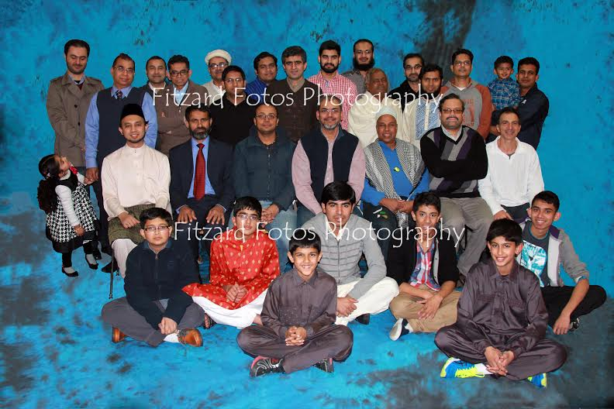

Slide 6
Eid Ul Adha event

Slide 7
January – March
GAMCI hold successful function to celebrate the prophet’s (PBUH) birthday (without funding). Involving recitation of Quraan; talks on the Prophet of peace; and surahs and performances by children.
Approached by GECC for membership on committee.
Discussions continue with Traralgon Cemetery for burial place for Muslims
GAMCI letter head developed
GAMCI begins to ask other Muslim organisations to put link on their web site.
GAMCI asked for comment on Latrobe Councillor stance on Islam
GECC Multicultural Day planned for 15 March Cancelled

Slide 8
April – June
GAMCI support walk by UMSLV Walk around the Lake Sunday 19 April Donations to Starlight Foundation.
Azaan caller for West Gippsland Anzac Day Celebrations.
Reclaim Australia rallies held across Australia, and GAMCI asked for comment.
At least two “racial” incidents which have occurred in the Muslim community in Gipsland. GAMCI sends emails to community members.
GMS organises meeting with Latrobe Mayor, and Victorian Police. GAMCI in attendance. Email sent to Muslim community.
Mats in Spiritual Centre cleaned by University.

Slide 9
GAMCI Thanks to:
Federation University Staff including Alan Scarlett
MUGSU and MUGSU Staff, including Nigel Beck
MUIS President and Committee, including President Md Shakif-Ul-Azan and Ahmed Ramadan
UMSLV President and Committee
GECC Committee, and Interfaith Sub-committee including Murray Lobely, Graham Dietrick
Dr Kamrul Islam (web hosting)
www.gamci.org

